Slide 1
Congestion Control
24.<number>

Slide 2
CONGESTION
Congestion in a network may occur :
number of packets sent to the network is greater than the capacity of the network
Congestion control mechanisms and techniques ->
control the congestion and
keep the load below the capacity.
24.<number>

Slide 3
24-2 CONGESTION
Congestion in a network may occur if the load on the network—the number of packets sent to the network—is greater than the capacity of the network—the number of packets a network can handle. Congestion control refers to the mechanisms and techniques to control the congestion and keep the load below the capacity.
Topics discussed in this section:
Network Performance

Slide 4

Queues in a router
24.<number>

Slide 5

Packet delay and throughput as functions of load
24.<number>

Slide 6
CONGESTION CONTROL
Congestion control techniques and mechanisms ->
Can either prevent congestion, before it happens, or remove congestion, after it has happened.
We can divide congestion control mechanisms into two broad categories:
open-loop congestion control (prevention)
closed-loop congestion control (removal).
24.<number>

Slide 7

Congestion control categories
24.<number>

Slide 8
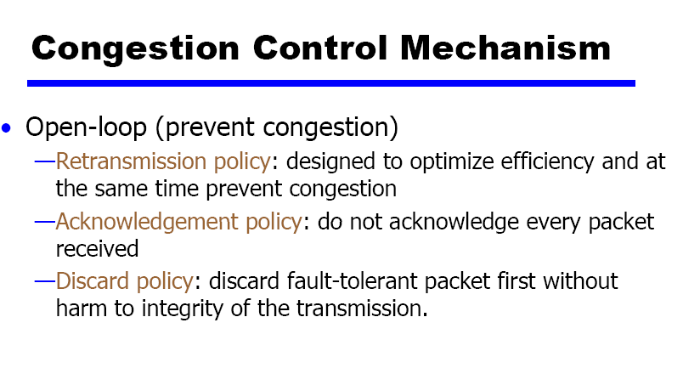

Slide 9
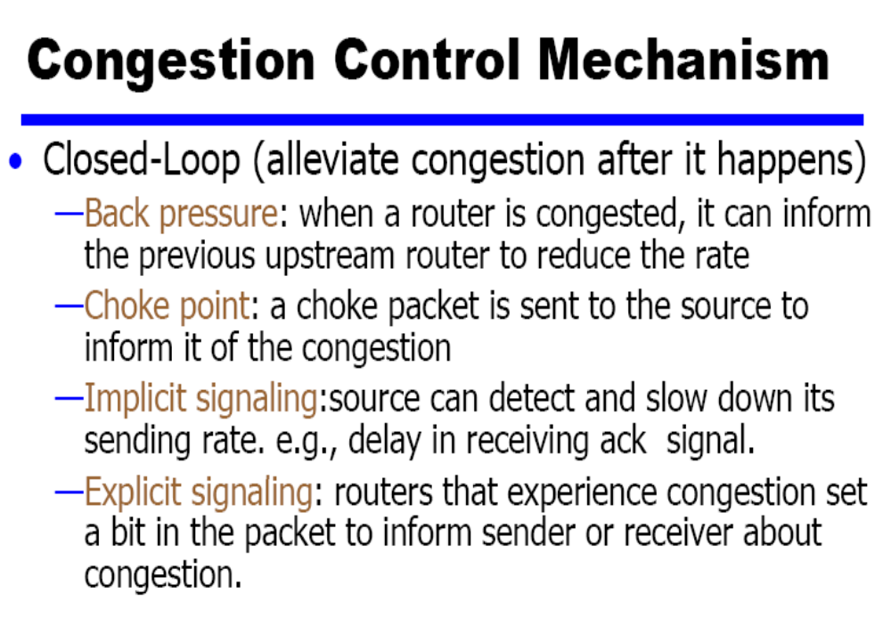

Slide 10

Figure 24.6 Backpressure method for alleviating congestion
24.<number>

Slide 11
Backpressure
If node becomes congested it can slow down or halt flow of packets from other nodes
May mean that other nodes have to apply control on incoming packet rates
Propagates back to source
Can restrict to logical connections generating most traffic
Used in connection oriented that allow hop by hop congestion control (e.g. X.25)
Not used in ATM nor frame relay
Only recently developed for IP

Slide 12

Figure 24.7 Choke packet

Slide 13
Choke Packet
Control packet
  Generated at congested node
  Sent to source node
  e.g. ICMP source quench
    From router or destination
    Source cuts back until no more source quench message
    Sent for every discarded packet, or anticipated

Slide 14
Implicit Congestion Signaling
Transmission delay may increase with congestion
Packet may be discarded
Source can detect these as implicit indications of congestion
Useful on connectionless (datagram) networks
  e.g. IP based
    (TCP includes congestion and flow control )
Used in frame relay LAPF

Slide 15
Explicit Congestion Signaling
Network alerts end systems of increasing congestion
End systems take steps to reduce offered load
Backwards
  Congestion avoidance in opposite direction to packet required
Forwards
  Congestion avoidance in same direction as packet required

Slide 16
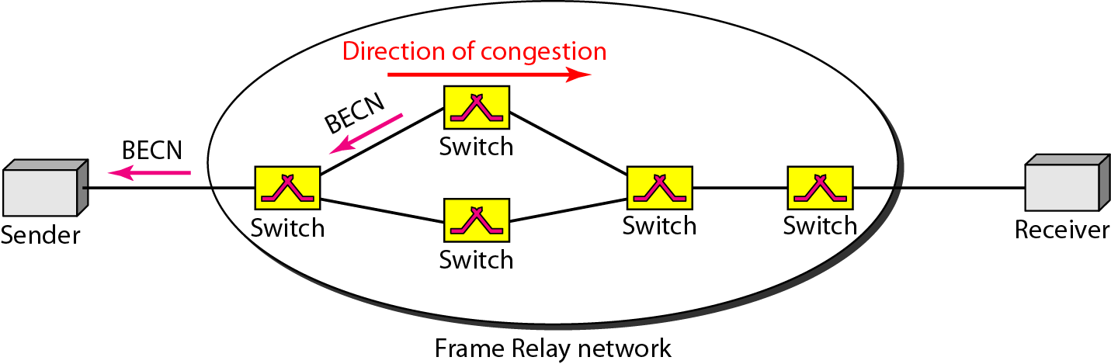
Figure 24.12 BECN

Slide 17
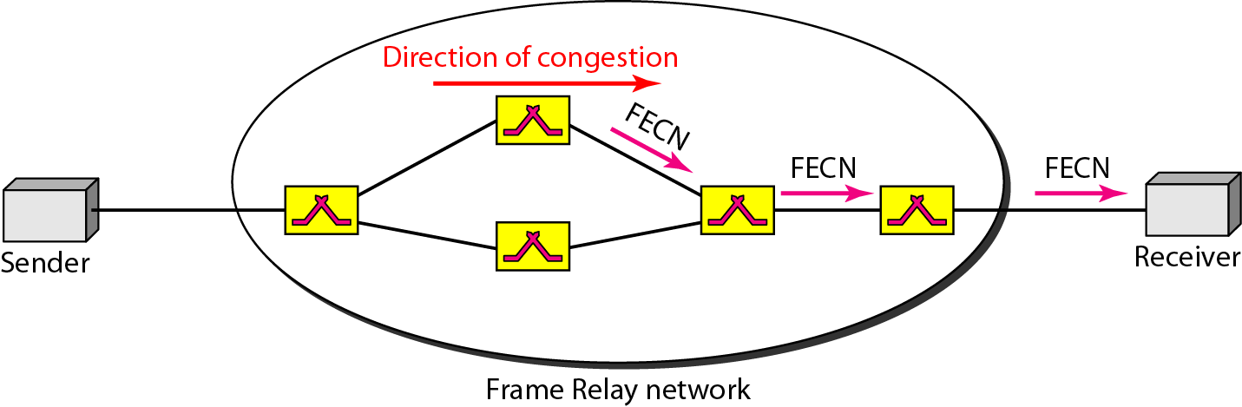
Figure 24.13 FECN

